Slide 1

COGNOS TOPICS
CBS APAC
2024

Slide 2


1
EUROPE ORGANISATION
I&S DEPARTMENT
WHO AM I ?

Slide 3


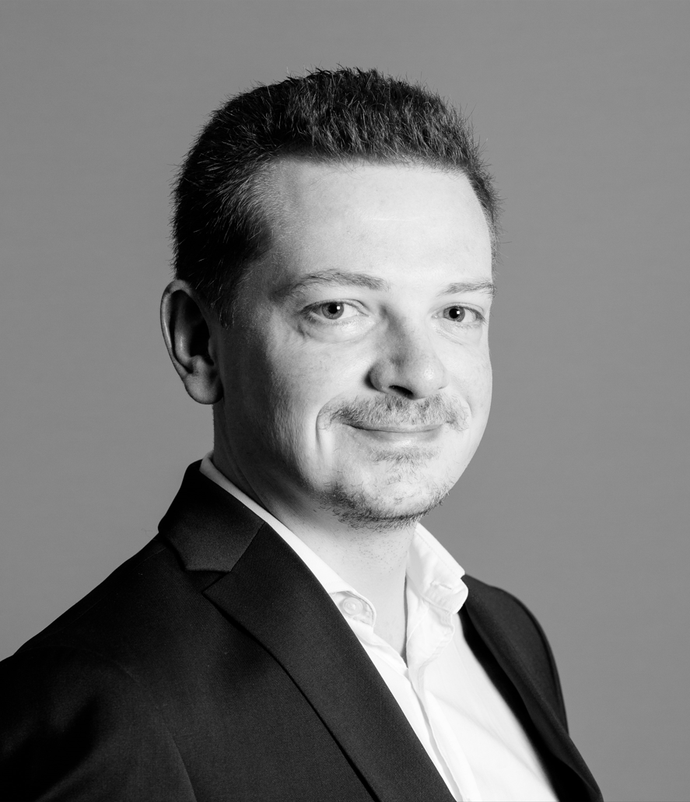







Implementation & Solutions Dept.
Anne
RECEVEUR
Christophe MONTEREMAL
Florent
DESAILLY
Renaud
BRAILLY
Cyril
GARDE
IMPLEMENTATION
Global Project Management for startegic account
- New Customers
- New Awards
Main Actions :
Sales Support, Planning Establishment, Project Coordination, Animation, Follow-up
CUSTOMER BUSINESS SOLUTIONS
Experts for IT Customer Solutions
- Project Management
- Sales supports
- Business View
Main Actions :
Solution Design, Specs, Test phasis, Training for EDI, Reporting, Track&trace and Web Platforms
BUSINESS INTELLIGENCE
BI Experts, data :
- Shipments data
- Milestones
- Finance details
- CO2
Main Actions :
Package Evolution, BI Platform Monitoring, Users Training, Benchmark
DIGITALIZATION
- Robot Process Automation
- New technologies, Apps
- Innovation
IA, Real Time Monitoring
Main Actions :
Market Watch, Benchmark, Organize & Paricipate to MVP or POC, Promote Solution
CONTROL TOWER EMEA
Customers dedicated Team
Main Actions :
Package Evolution, BI Platform Monitoring, Users Training, Benchmark
CUSTOMER REPORTING
FO REPORTING
MO REPORTING

Slide 4













EUROPEAN CBS COMMUNITY
Organization
REGIONAL CBS
A. Adjtoutah
L. Breton
HOC EUROPE
C. Montérémal
MAJOR ACCOUNTS
O. Grekov / L. Gouraud
M. Pasquier
France
31 CBS
Europe
21 CBS
Verticals
3 CBS
NORMANDY /
NORTH
PARIS AREA - LUX
ITALY
NETHERLANDS
ENERGY /
INDUS. PROJECT
C. Mariet / B. Ilboudo / C. Adam T. Chauvin / T. Hoareau / TBN
S. Zieba / N. Astudillo
D. Tavernier / A. Humbert A. Lakicevic / E. Druon
I. Jaber
A. Addea
F. Cavanna
TBN
P. Ofori Van Zanten
H. Villedey
E. Jamin
GREATER EAST
CENTER
BELGIUM
GERMANY*
HEALTHCARE
A. Moreau / H. Malrieu
F. Sarkissian / A. Bouix
B. Brigitte / A. Gautier / TBN
C. Julliard / A. Blin
M. Henry / F. Teubou
K. Van Mechelen
JC. Estival / P. Renault
N. Siegfried / C. Orent
M. Kosanke/ M. Schmidtke
M. Kroos / TBN
T. Curt
WEST
OCCITANIA
SPAIN
UK*
AEROSPACE
E. Feltgen
P. Sicot
T. Vallet
B. Picornell
R. Guerra
S. Stringer / I. Kober
V. Javadian / P.Greeff
F. Bochent
FR. TERRITORIES
SOUTHWEST
PORTUGAL
HOROZ Bolloré
F. Legendre
L. Dorrifourt
M. Leveneur
TBN
C. Voiteque
TBN
H. Cardador
TBN
SOGETRA
*EU CENTRAL COUNTRIES
*NORDIC COUNTRIES
SWITZERLAND
Handled by Germany
Handled by UK
J. Cabioch
L. Laguiller
V. Marioton / A. Antoine
Notes:
CBS full time
Central : 4 Regional CBS
Verticals : 3 Experts
France : 26
Europe : 19
Intern : 5 in France + 1 at regional level
VIE : 1 in NL + 1 in BE
On going recruitments :
Intern : 3 in France (FT + Normandy + South West) + 1 at Regional level + 1 for Aero
Full time : 1 in IT + 1 in South East +1 in Normandy
POLARIS replacement
Specificities :
Sogetra : only 49% part of Bolloré but having same processes and tools ➔ part of the team
Germany : supporting EU Central Countries
UK : supporting Nordic Countries
Horoz Bolloré : had a CBS but not anymore – looking for recruiting

Slide 5
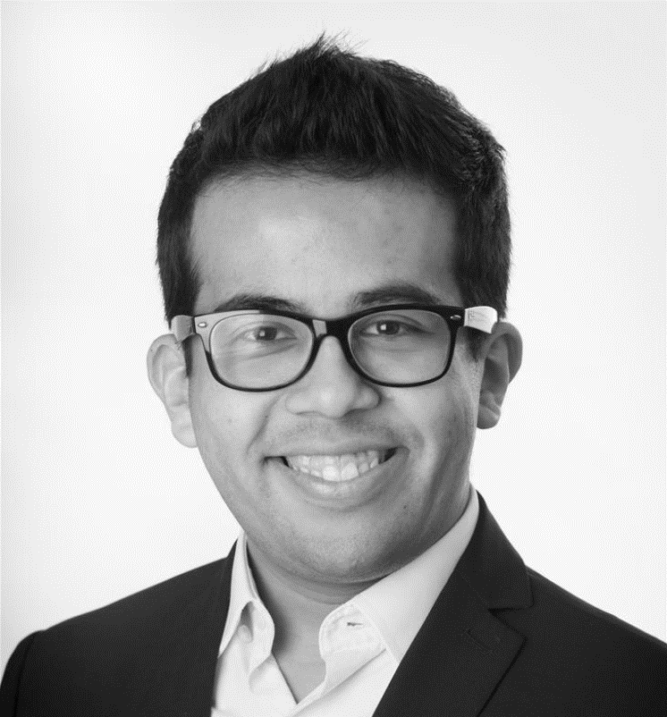


BI EUROPE
Dedicated stream | Dedicated team
Florent DESAILLY
Sebastian PALACIOS
Joshua MENDOZA
Maxime MARTIN
BUSINESS INTELLIGENCE
BI Experts, data :
- Shipments data
- Milestones
- Finance details
- CO2
Main Actions :
Package Evolution, BI Platform Monitoring, Users Training, Benchmark
SUPPORT CBS LVL1
REPORTING FO & MO
EXPERTISE : DATA & REPORT
CR&KPI
LINK BI
Pack FI V3
Cognos
Tableau
Power BI (on going)
…

Slide 6
2
DATA TRANSFORMATION PROJECTS OVERVIEW

Slide 7

DIGITAL TRANSFORMATION PROJECTS OVERVIEW
CW1 | POLARIS | ONE COCKPIT
 | CW1 | POLARIS | ONE COCKPIT
CONTEXT | Deployment new TMS WW | IT architecture reshaping with new technologies Replacement of LINK with additional functionalities (Kontainers,…) | Replacement of Infocenter with new technology and new connections (internal/external sources) Databricks + PBI
STATUS | Americas : Done APAC : Done Europe : on going MESA : Done | Progam organization onboarded Planning established V0 in deployment | Project scoping Dedicated coord. team creation DS Finance & CR designed
NEXT STEPS | FR AIR (Apr 2023) BE CH UK | V1 Defined V2 … | Finalize CR Build Procurement DS Transition organization Ramp up 2024 Infocenter decomisionning

Slide 8
3
BOLLORE LOGISTICS INFORMATION SYSTEM

Slide 9









BUSINESS TOOLS
BOLLORE LOGISTICS ASSETS
1
C
TMS’
CRM
Transport Management System
• Mercure (EU)
• Pegase (ASPAC, AMERICAS, MESA)
• Cargowise aim to replace legacy
Customer Relationship Management
CONCERTO is used by sales to monitor their activity towards customers.
CARGOWISE
CONCERTO
MERCURE
PEGASE
LINK
MDM
Tracking tool, connecting TMS jobfiles, interfacing EDIs, ...
Master Data Management
MOÏRA manages referential data (UN/Locode, Container types, HCC*...)
MOÏRA
TOM
EXT
DMP
“Transport Order Management”
Optimizing Shipment
BUS
All the external softwares that enrich our transport data.
eg: EcoTransit
Quotation tool
DMP
*Harmonised Charge Codes

Slide 10
BUSINESS TOOLS
INTERCONNECTED
MDM
Information shared between tools, and especially TMS and LINK
DMP
CRM
1
C
CARGOWISE
MERCURE
PEGASE
TMS
Notes:
There is no order in below list except 1st bullet point (SHP creation)

Slide 11



DATABASES
FOR REPORTING
INFOCENTER
Microsoft Based Technology
Datawarehouse to collect and store massive amount of data.
LINK BI
DATAMARTS
& Data Tables
Replica of LINK's live-tracking data.
Server monitored by BI Team.
Are specific to clients or external sources for specific usage.
eg: Ecotransit, L'Oréal, GE, Faivelay, Givaudan, Airbus
Notes:
There is no order in below list except 1st bullet point (SHP creation)

Slide 12
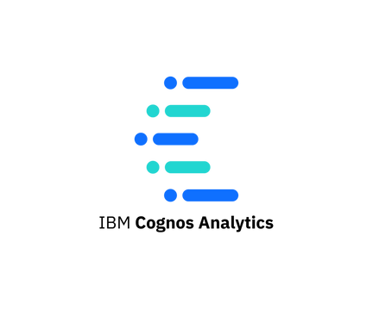





DATA FLOW
GLOBAL ARCHITECTURE
...
ARGOS_V3
CR & KPI
ECOTRANSIT
PACK FI V3
LINK BI
INFOCENTER
DATAMARTS
& Data Tables
LINK BI
TMS
CRM
MDM
EXT
LNK
C
1
CW1
MERCURE
PEGASE

Slide 13
4
CW1 UNIQUE JOBFILE CONCEPT

Slide 14






SHIPMENT CREATION | MAIN INFORMATION CAPTURED
FULL CW1
S
Shipment
Transport Order Management
C
Consol
EXPORT PHASE
IMPORT PHASE
CONSOL ATTACHMENT
MEASURES
REFERENCES
SHIPMENT CREATION
RELATED
ORGANIZATION
EVENTS / DOCS
INVOICING
INFOCENTER
EVTS / DOCS : Evts pushed to LINK (XUE) | Docs pushed to LINK (XUD) unless exception rule monitored by TOM
MEASURES : Pushed to LINK & Infocenter. Updated via ops data (Infocenter) or via XUS (LINK)
CONSOL ATTACHMENT : Consol info are flowing to the shipment in LINK & Infocenter. Calculation of LNK SHP Type / Argos activity
SHIPMENT CREATION : Once validated in TOM, TOM generates the shipment (and console) in CW1. As soon as the IFFO saves the shipment, it generates FCREA and triggers the 1st XUS.
INVOICING : invoices sent to Infocenter (exception for EDI)
REFERENCES : Pushed to LINK via XUS, partially to Infocenter
RELATED ORGANIZATION : Pulled from Moira into CW1, and pushed to Infocenter, and partially to LINK (if orga has LINK code)
Notes:
There is no order in below list except 1st bullet point (SHP creation)
Consol attachment rappeler les notions de OPS data avec décalage de 48h versus envoi XUS à LINK
À voir avec Laurent :
RELATED ORGANIZATION : Partially to LINK (if orga has LINK code) => qu’est ce qui est envoyé à Link et en quoi c’est partiel ?
A. Addea : In case we modify the organization in Moira, will it update the data in CW1 and as well in infocenter ?
A. Addea : What about the case when Infocenter wil be connected to Moira ?
REFERENCES : est-ce que les REF natives CW1 remontent bien directement de CW1 vers Infocentre ?

Slide 15
SHIPMENT CREATION | MAIN INFORMATION CAPTURED
FULL CW1
S
Shipment
Transport Order Management
C
Consol
EXPORT PHASE
IMPORT PHASE
CONSOL ATTACHMENT
MEASURES
REFERENCES
SHIPMENT CREATION
RELATED
ORGANIZATION
EVENTS / DOCS
INVOICING
INFOCENTER
Notes:
There is no order in below list except 1st bullet point (SHP creation)

Slide 16
5
CW1 DATAFLOW

Slide 17



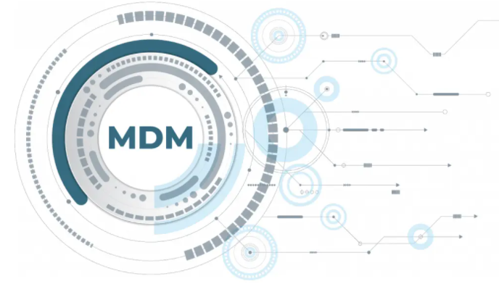
DATA FLOW
GLOBAL ARCHITECTURE
DATABASES
SUN
IRIS
HERMES
KEY POINTS
No direct transmission
Multiple layers / enrichment
Variable Freshness
IMPACTS
Desynchronization of DB
Loss of data in complex ecosystem
CONSEQUENCE
DQ (not related to ops)
ACCOUNTING SYSTEMS
INFOCENTER
Manual Trigger or
Phase update
XUS / XUE / XUD
FLAT FILE
1 / day
DL
MOIRA
Trigger Invoice
BUS
TRANSACTION JSON
FBI
Compilation of JSON file (1/day) company per company
DL (Distribution Layer) calling for CCN
Financial transactions (5min) & Ops Data (1/day)
transmitted to FBI (Financial & BI)
CW1 objects (shipments, consols, evts, docs, …) pushed live by trigger
Notes:
Sur quel système comptable se repose CW1 ?
DE question : is it only new information send to infocenter or the whole jobfile data is erased/ replaced ?
Ops data identifies 1 modification on a SHP then resend all SHP information to Infocenter.
Cas d’un changement de POL. Côté LINK => XUS re-généré pour renvoi. Côté BI : mise à jour 48h (Ops Data)

Slide 18
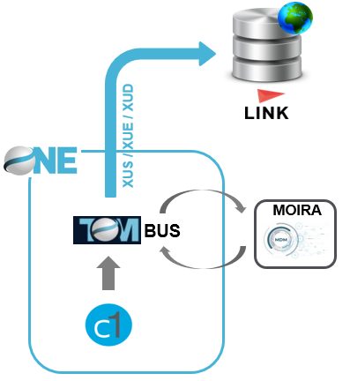
DATA FLOW
ZOOM INTO XUS / XUE / XUD
By trigger, CW1 generates standard XML files for communication, namely
XUS : contains n shipment(s) and/or n consol(s) info & related information (CCN, UM, UC,…)
XUE : contains evts (« milestones »). 1 XUE = 1 EVT
XUD : contains docs
XUT : contains invoices (LINK FAC)
XUE or XUD cannot be processed if an initial XUS containing proper source object info has not been through
TOM BUS allocates a header to XU’x for proper routing into LINK
BUS
n Consol
n Shipments
XUE
XUS
n CCN Master
n CCN Sub
XUD
ADDING HEADER
CCN
3rd party transco
UC + UM
TR #
MOIRA
Notes:
See it as an internal EDI between ops tool and LINK

Slide 19


DATA FLOW
INFOCENTER <> LINK EXCHANGE
EVT + REF
DENORM
20’
INFOCENTER
LINK BI
INFOCENTER
LINK BI
Evts
Refs
SHP (fact_expedition / GTN)
Related parties
Refresh update : twice a day 9 AM & PM FR
Sales Invoices (header + total)
Related parties (ex 3rd party TMS code)
Refresh update : nightly
Notes:
Moira Transco example : PCK is known as package by CW1 but LINK only knows CTN value
XUE : Evts auto + XUS Light (manuals evts)
XUT : “Transaction” for LINK FAC (customer invoices via EDI)
SHIPMENT CCN based on Branch & Dept + counter for Numdoss
CONSOL CCN based sending & receiving agent :
sending agent gives branch of departure
receiving agent gives TMS & branch of destination
LINK => INFOCENTER : 3rd parties from LINK database (incl 999999 transac) C_FACT_INTERVENANTS
INFOCENTER => LIN. : 3rd parties from Infocenter sent to LINK when matching (ex: role EXP = Shipper)

Slide 20
6
INFOCENTER / COGNOS PERFORMANCES

Slide 21
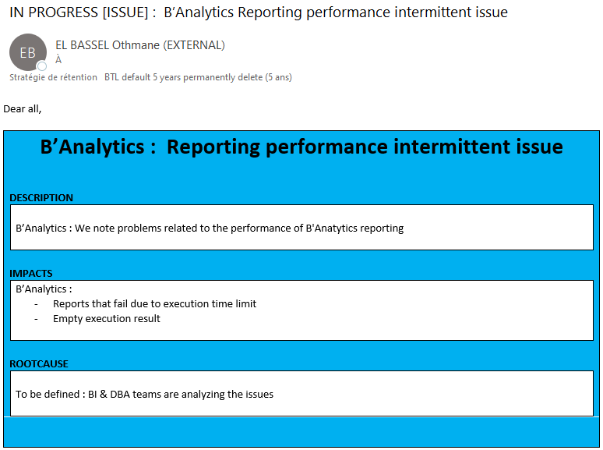
INFOCENTER / COGNOS PERFORMANCE ISSUES
STILL IN PROGRESS / UNDER ANALYSIS…

Slide 22
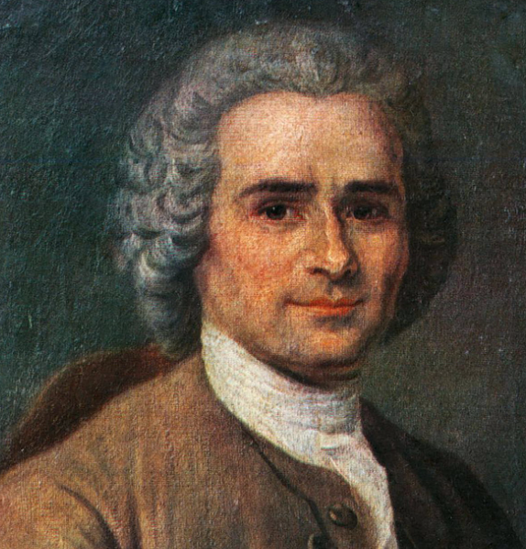
INFOCENTER / COGNOS PERFORMANCE ISSUES
PERFORMANCE IS EVERYONE’S RESPONSIBILITY
“One person's freedom ends where another's begins”
Rousseau (1712 - 1778)
FACTS :
MOVE DC (Data Center) 15/09 & 24/11
Late data loads or data load incidents
Network shutdown 12/13 October
Permanent performance issues since 22/12 => Impact on big Customers where ops depend from BI reports (Dior Couture & Kering)
POTENTIAL ROOT CAUSES :
1. Burst Cognos : mass diffusion function => generates several SQL queries for 1 report
1 user impacting all
2. Saturation of Cognos report versions:
Too many reports may overwhelm the platform. Threshold effect provoking Cognos engine to lose performance
Cleaning of olde Cognos objects will be done => Create Archive folder for all Apac and store unused objects (views, reports, folders, jobs) or delete them.
3. End of the year peak effect : YTD reports stirring lot of data
4. Plateforme usage: (re) identify prioritization of reports
5. Other technical root causes under analysis:
Balance analysis, network, Database, Cognos package fixes…
PENDING OFFICIAL COMMUNICATION FROM BI

Slide 23
7
USERS’ VOICE :
QUESTIONS

Slide 24

USERS’ VOICE
QUESQTIONS
APAC Cognos Workhop Questions.xlsx

